Slide 1
Deconvolution Methods
dtangle
MuSiC
CibersortX
Dataset: Mathys
Single-cell transcriptomic analysis of Alzheimer’s disease

Slide 2
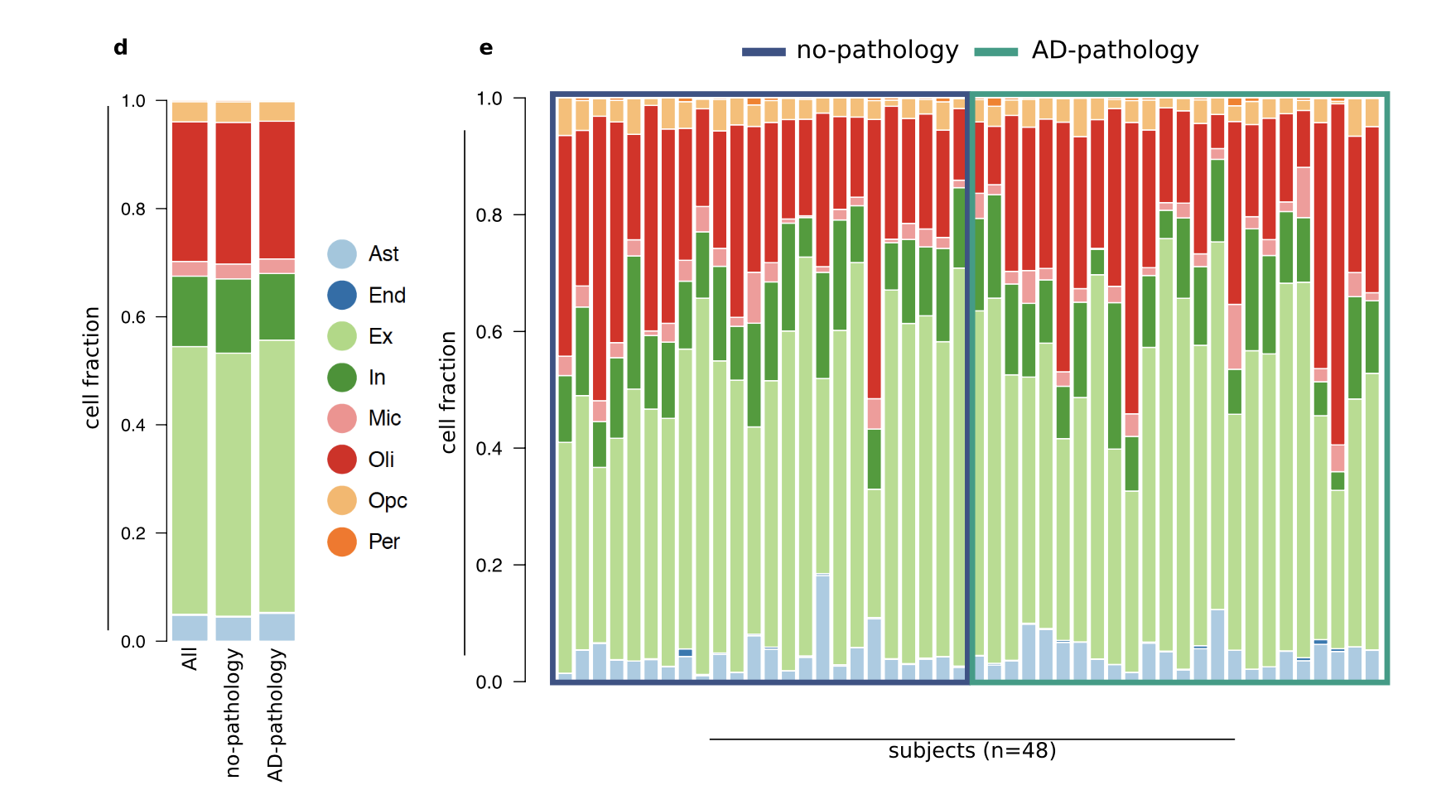
Bulk dataset information from the paper

Slide 3
dtangle
Input data:
1. bulk dataset
2. snRNA seq dataset
STEPS:
1.Find the genes that are common to both reference and bulk data sets and join the data sets using them.
2.Apply quantile normalization in order to ensure that they are indeed comparable
3.Create an object that collect pure samples of each cell type (come from sNRNA)
4.Find marker genes
5.Perform dtangle

Slide 4
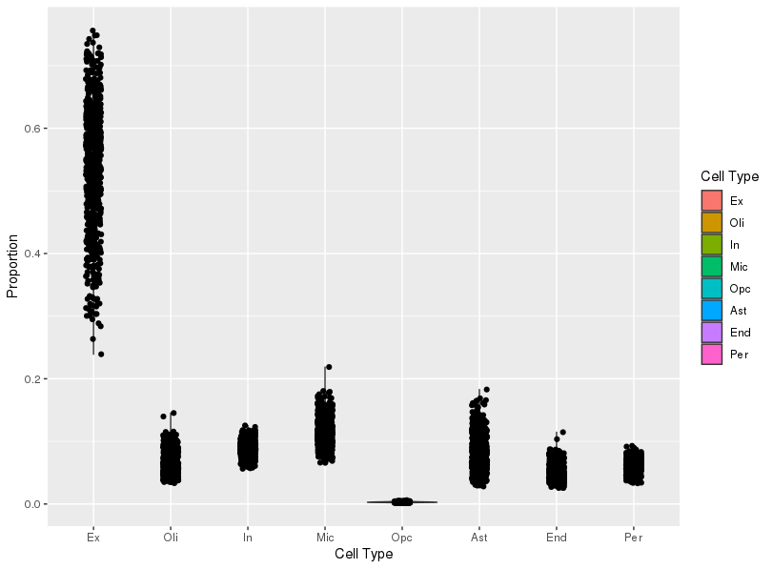
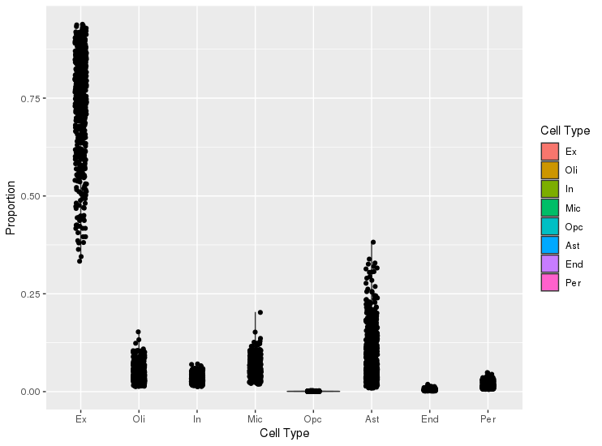
dtangle
snRNA reference contains both control and AD
snRNA reference contains only control cells

Slide 5
MuSiC
Input data:
1. bulk dataset (as expressionset)
2. snRNA seq dataset (as expressionset)
TWO main functions:
1. Basic estimation of cell type proportions. (Instead of selecting marker genes, MuSiC gives weights to each gene. The weighting scheme is based on cross-subject variation: up-weigh genes with low variation and down-weigh genes with high variation)
2. Estimation of cell type proportions with pre-grouping of cell types. (To deal with collinearity, MuSiC employs a tree-guided procedure that recursively zooms in on closely related cell types. Briefly, first group similar cell types into the same cluster and estimate cluster proportions, then recursively repeat this procedure within each cluster)

Slide 6
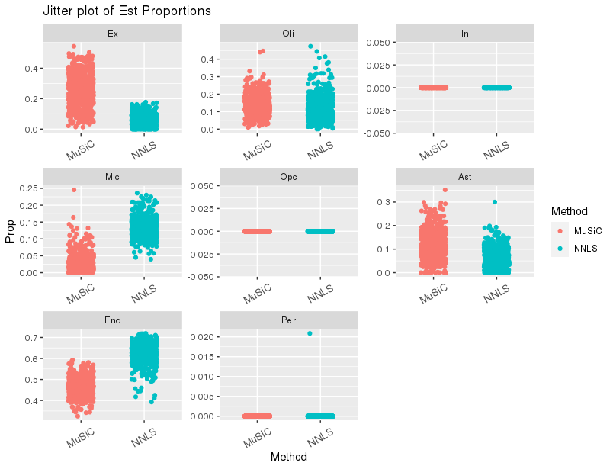
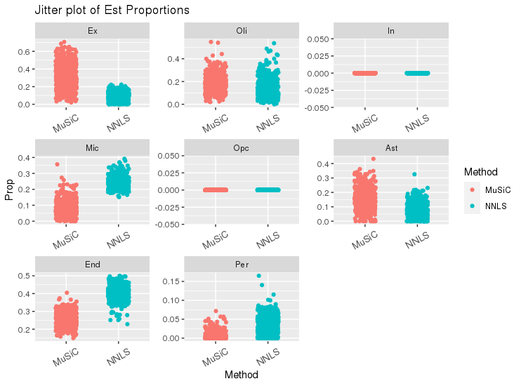
MuSiC: Estimation of cell type proportions
snRNA reference contains both control and AD
snRNA reference contains only control cells

Slide 7
MuSiC: Estimation of cell type proportions with pre-grouping of cell types
Clustering single cell data
produce design matrix, cross-subject mean of relative abundance, cross-subject variance of relative abundance and average library size from single cell reference.
get a tree0based clustering of the cell types using the cross-subject mean matrix and the design matrix.
#Disgn.mtx: gene by cell type matrix of design matrix (metadata of reference)
#M.theta (mean of RA): gene by cell type matrix of average relative abundance

Slide 8
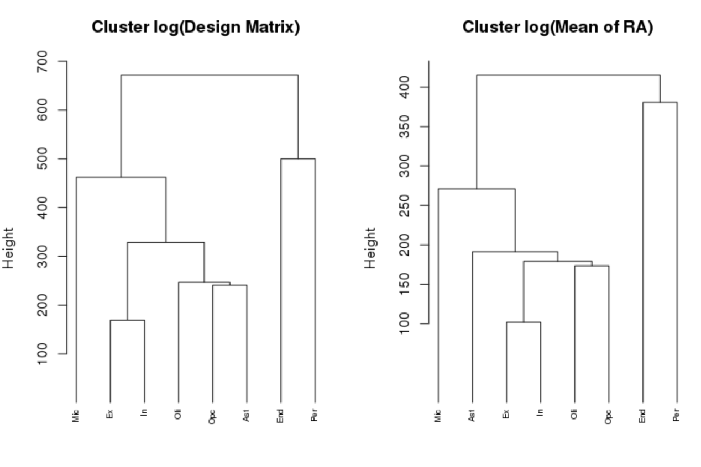
MuSiC: Estimation of cell type proportions with pre-grouping of cell types
Should be split into 4 groups:
G1: Mic
G2: Ex, In, Oli, OPC, Ast
G3: End
G4: Per

Slide 9
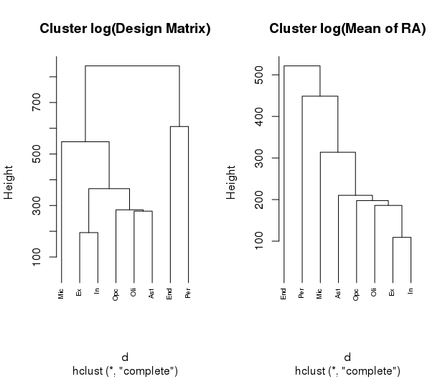
tree plot from only control cell reference

Slide 10
MuSiC: Estimation of cell type proportions with pre-grouping of cell types
After get 4 groups, annotate groups and clusters. Then select DEGs for clusters that contain multiple cell types (group2)
I use seurat here to collect DEGs of cell types inside of cluster (group2: Ex, In, Oli, OPC, Ast). Top 283 DEGs from seurat are used.
Estimation with pre-clustering of cell types

Slide 11
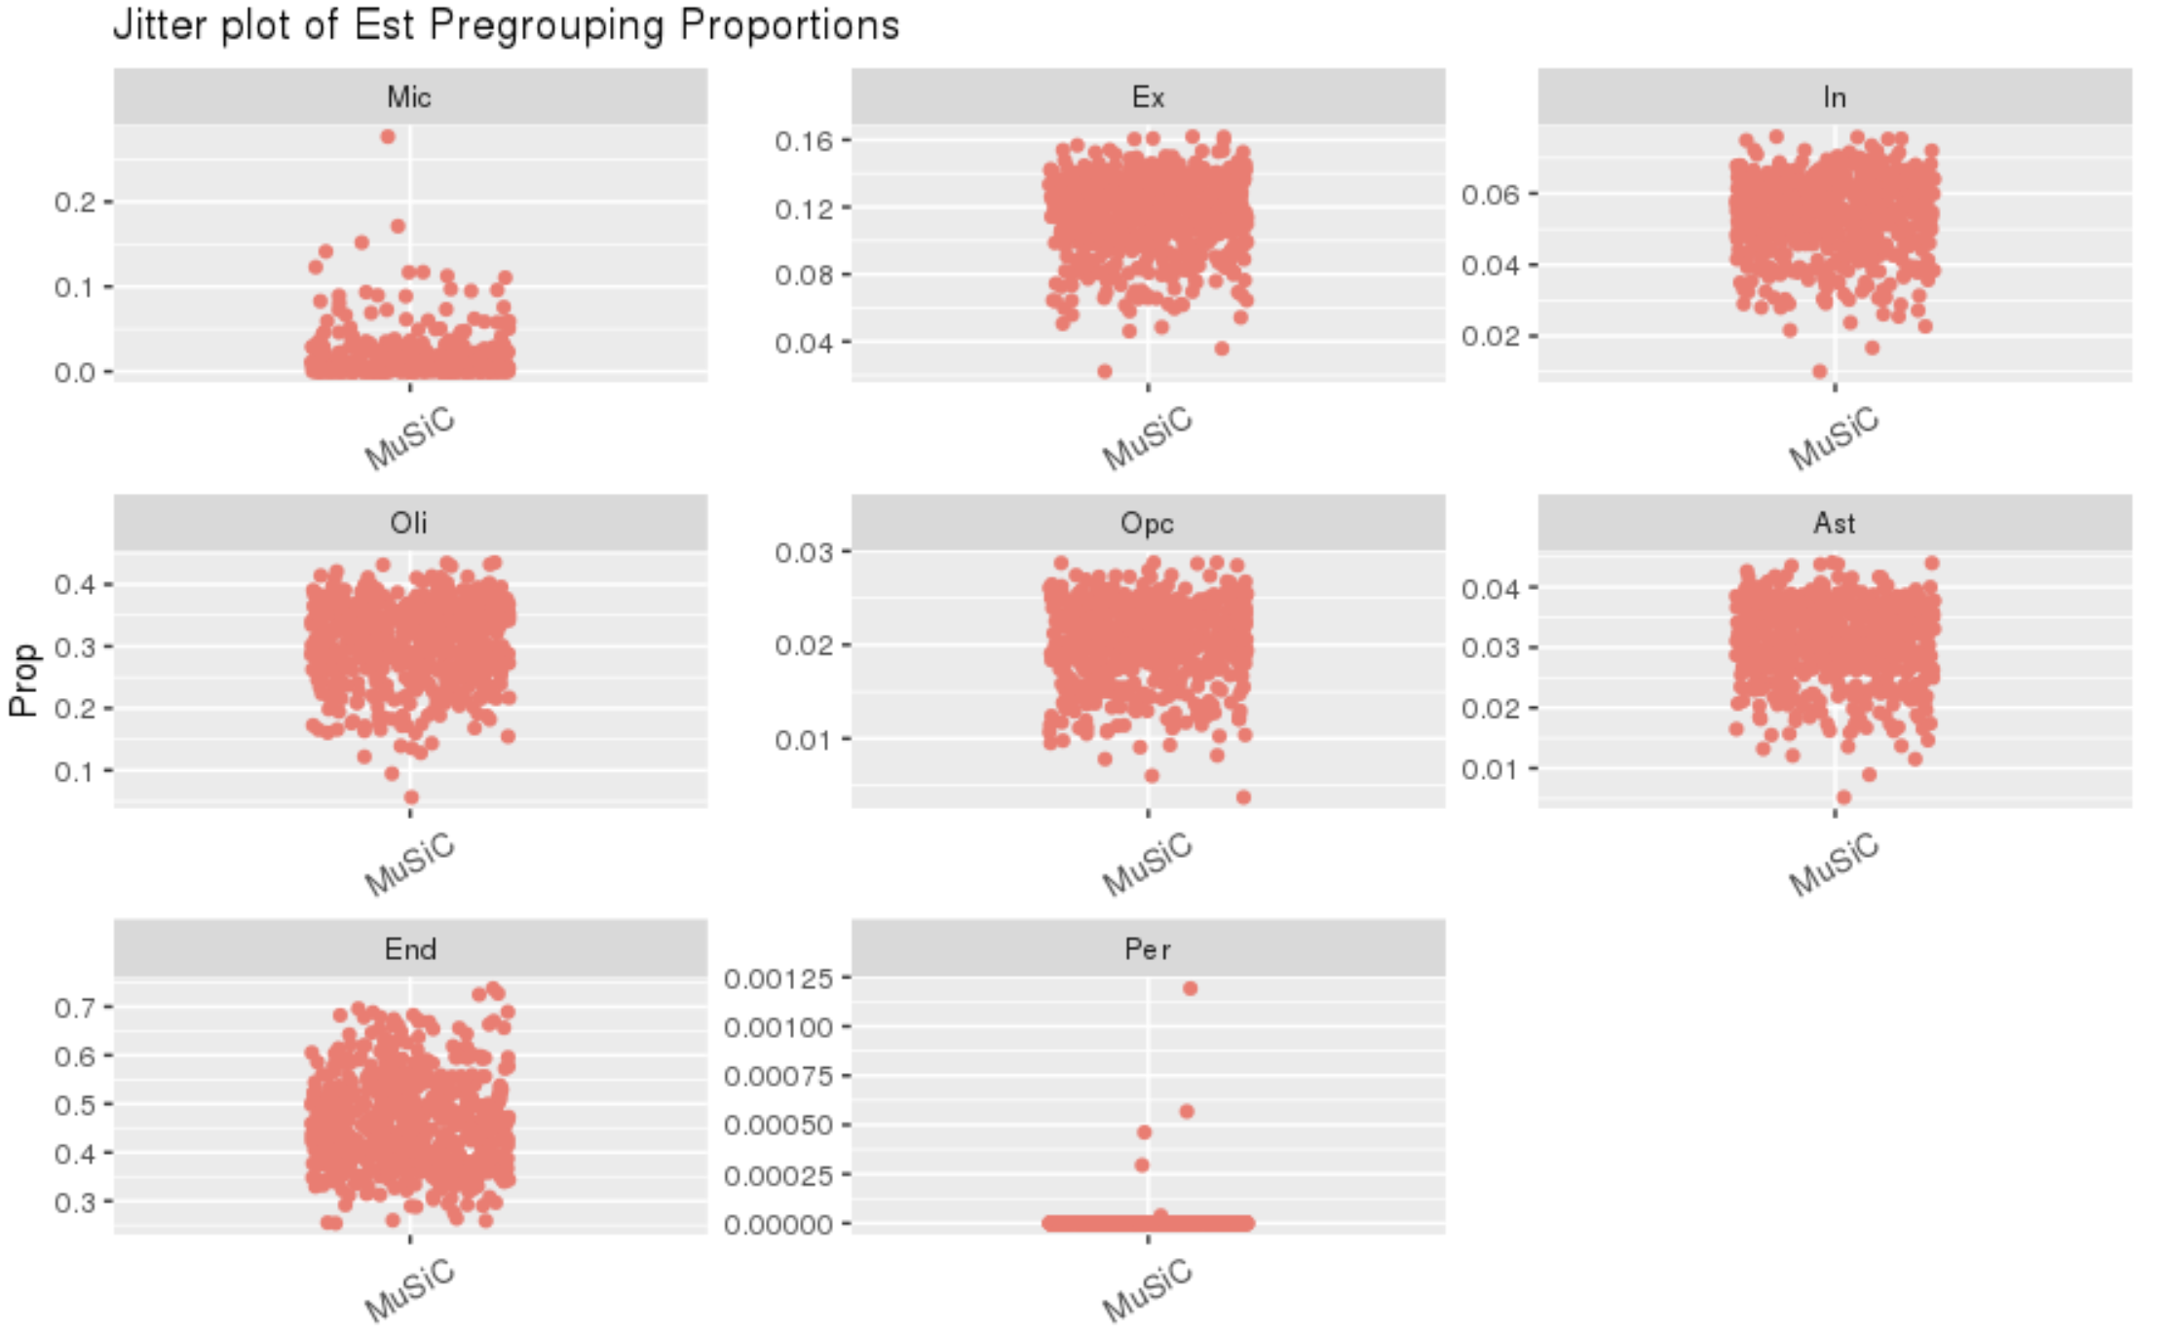
Pregrouping (all cells)

Slide 12
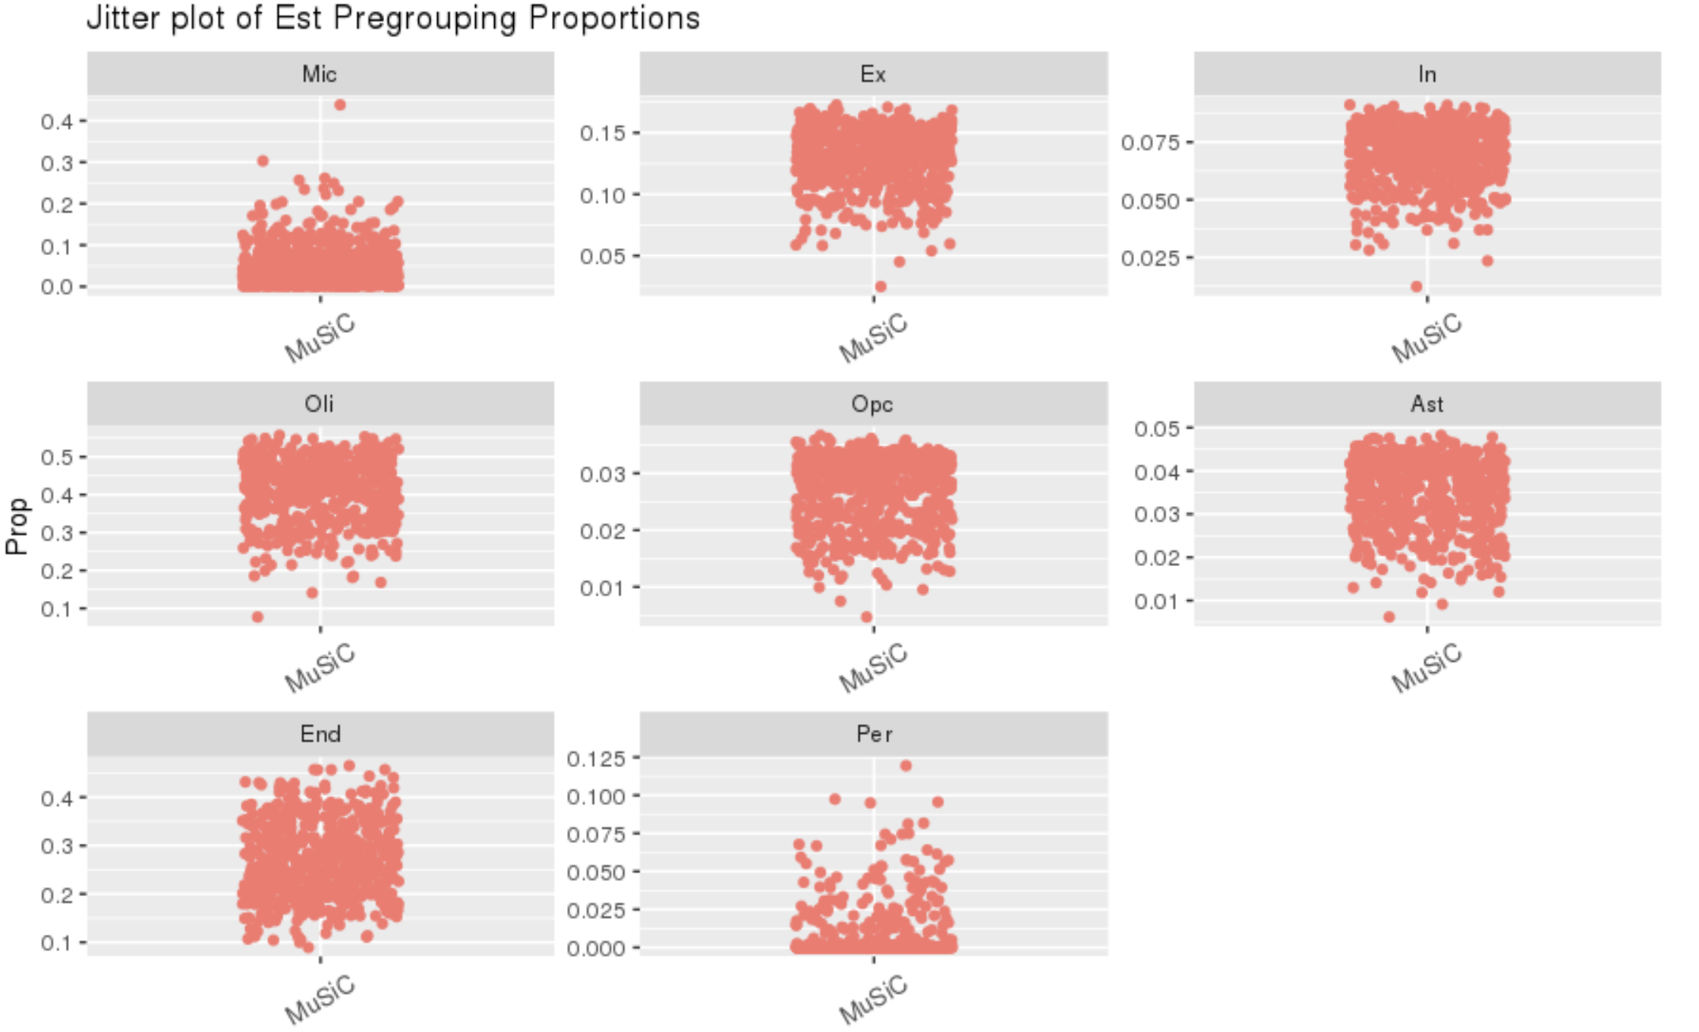
pregrouping (only control cells as refrence)

Slide 13
CibersortX
Bescuse of the reference size limitation (upload datasets should smaller than 1,000 Mb), make reference snRNA only includes control cells and genes that expressed >20. Based on that, 2 ways to filter out cells and genes in control snRNA reference.
1. Cells were selected in proportion to the number of cells contained in each cell type in the snRNA data. (416Ast, 16End, 4559Ex, 1286In, 257Mic, 2453Oli, 356Opc, 24Per)
2. Filter out cells that 9,000>sum gene expression >4,000 and genes that expressed <20. To make up for the cell type with fewer cells, choose cells randomly in that cell type so that each cell type has no fewer than 25 cells (25Ast, 25End, 6271Ex, 1058In, 25Oli, 71Opc, 25Per,25Mic)

Slide 14
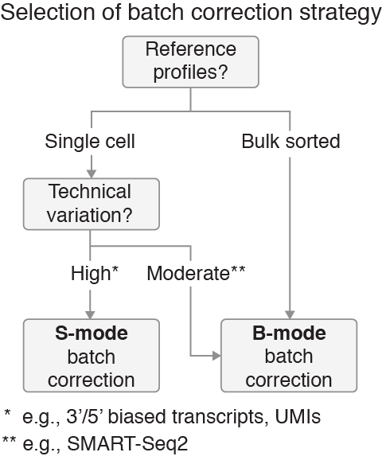
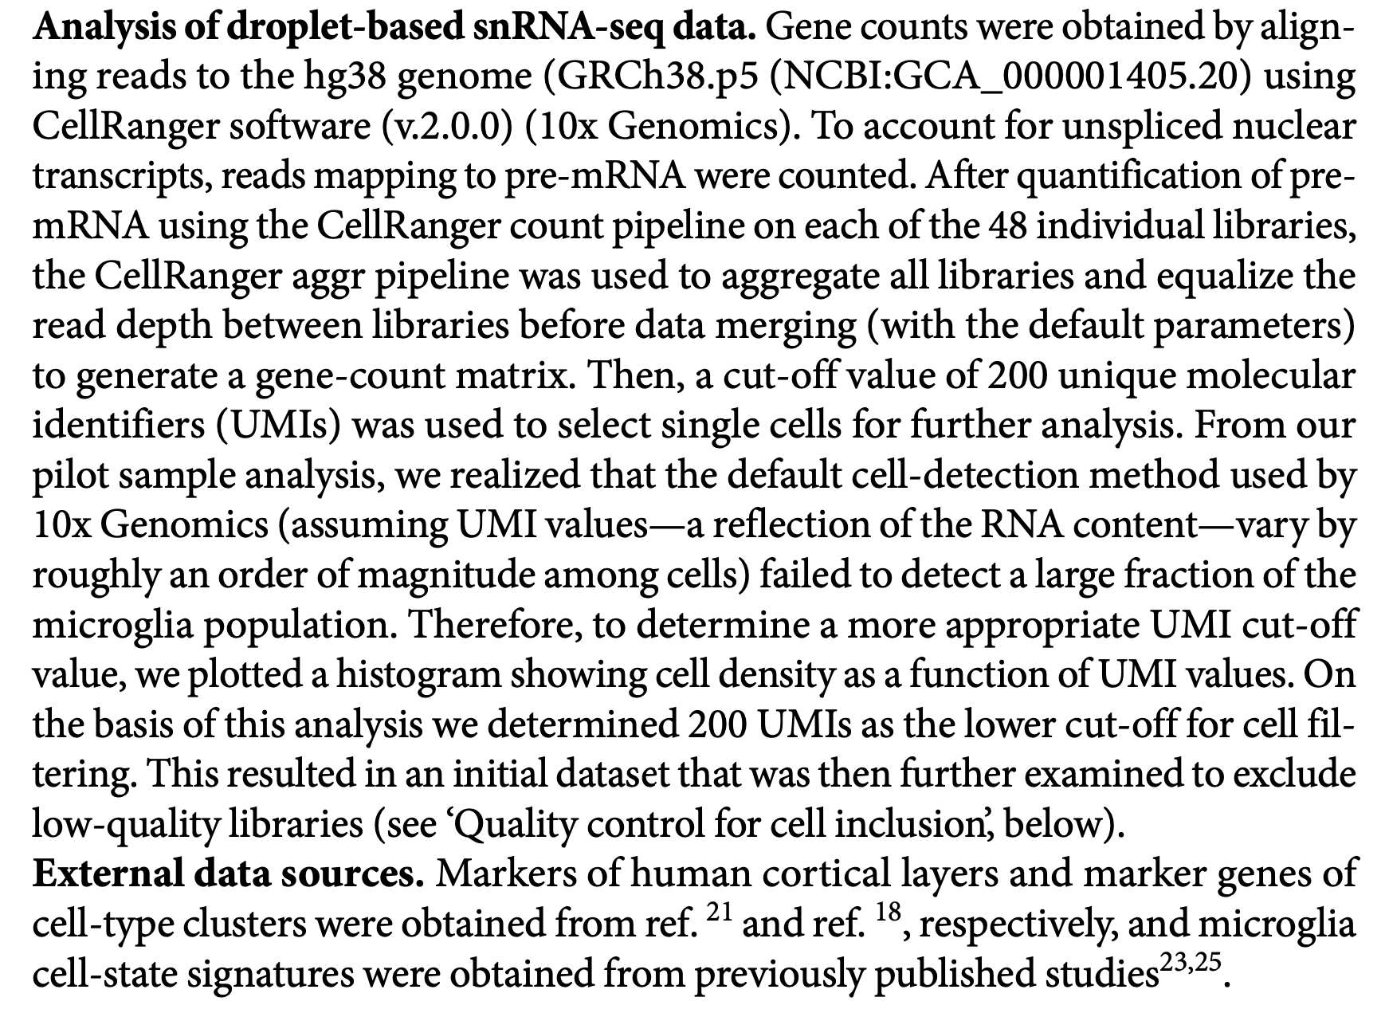
Criterials to select mode
Based on metadata and method from Mathys' paper, S mode is a better choice.

Slide 15
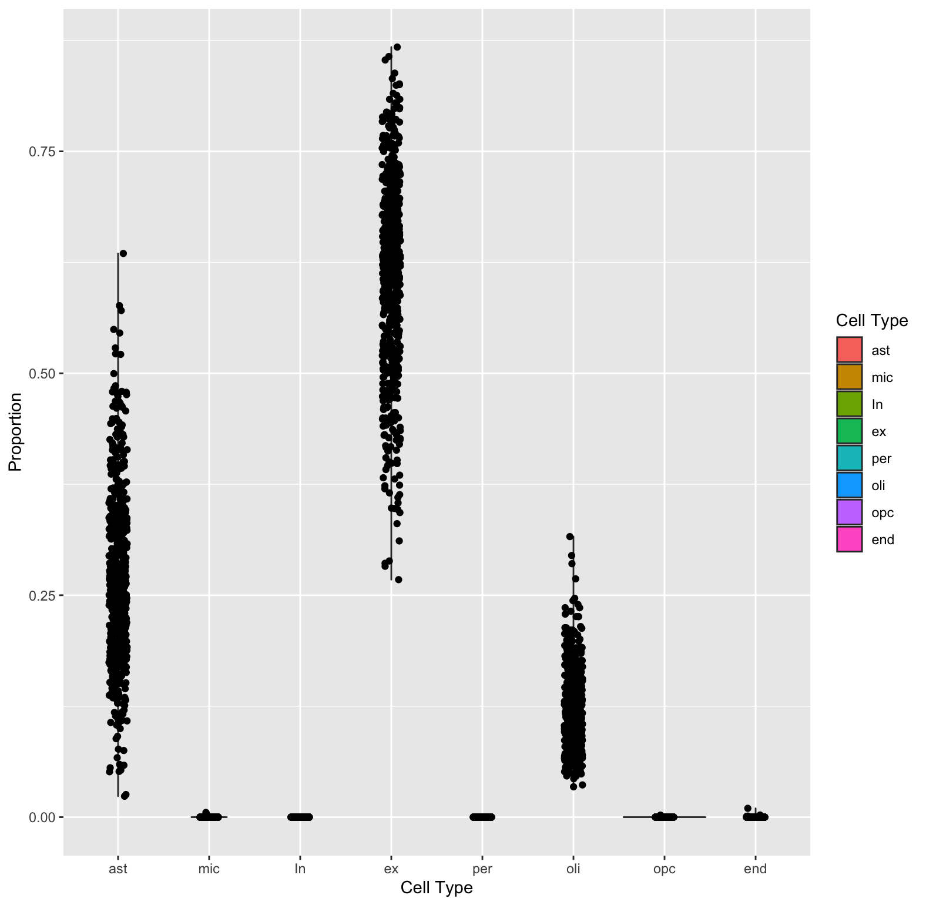
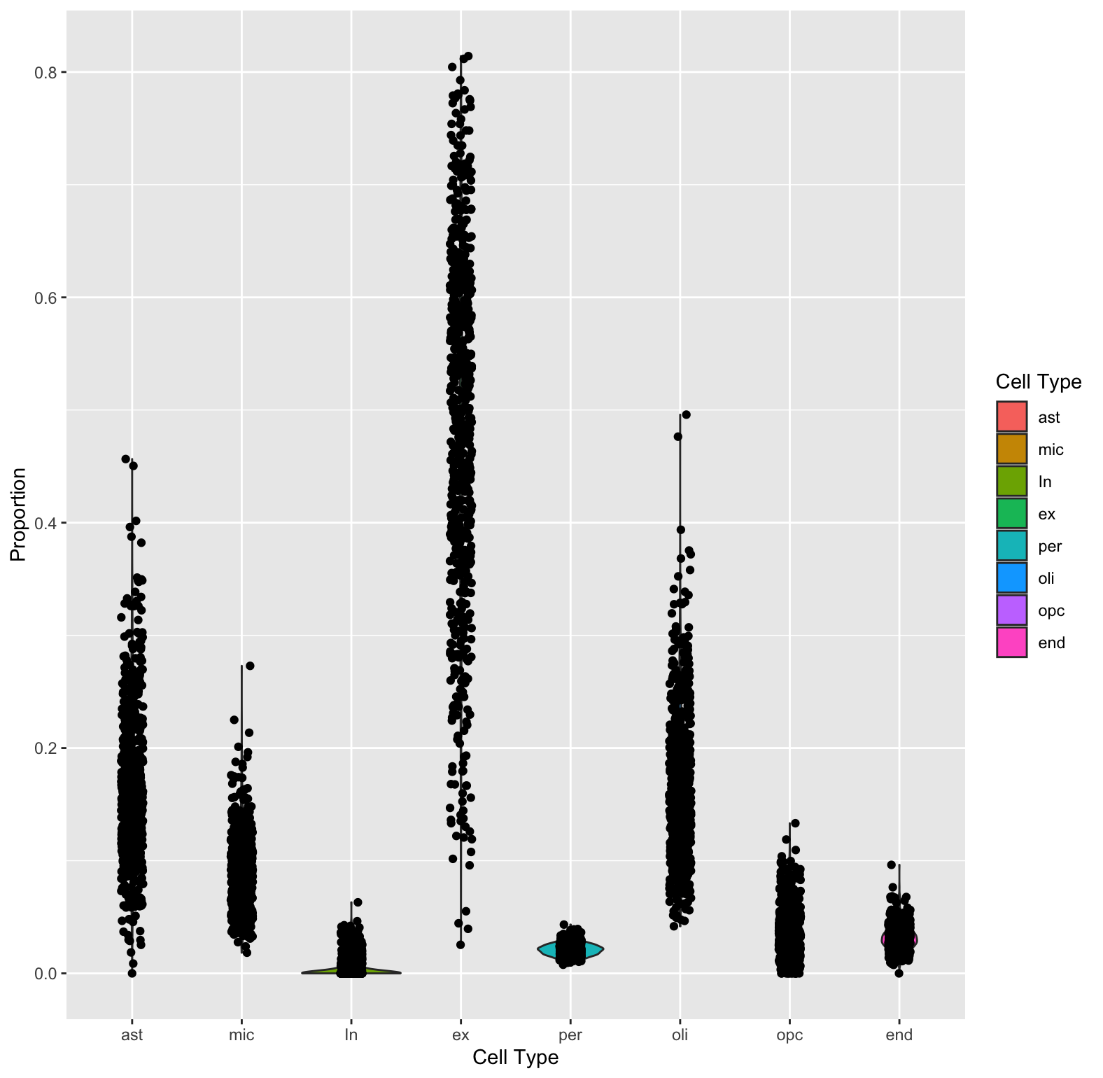
Just a comparison (use both AD and control cells, select 15% cells from snRNA dataset randomly)
All cells in B mode
All cells in S mode

Slide 16
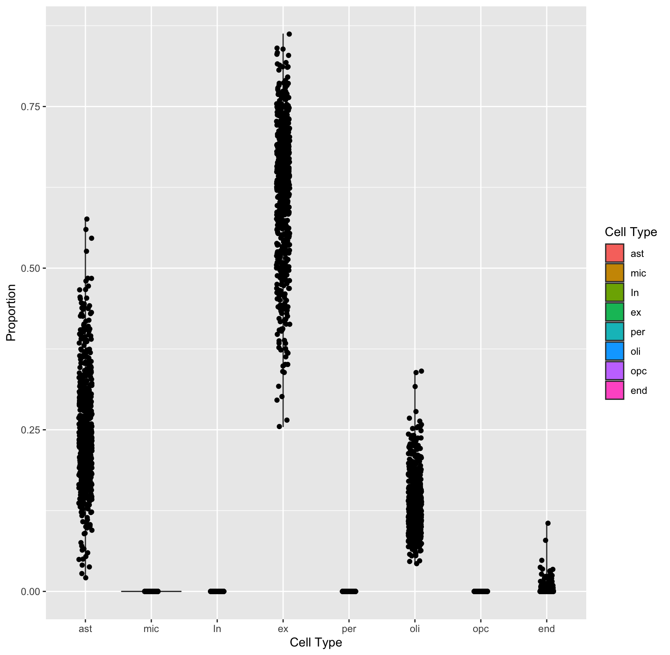
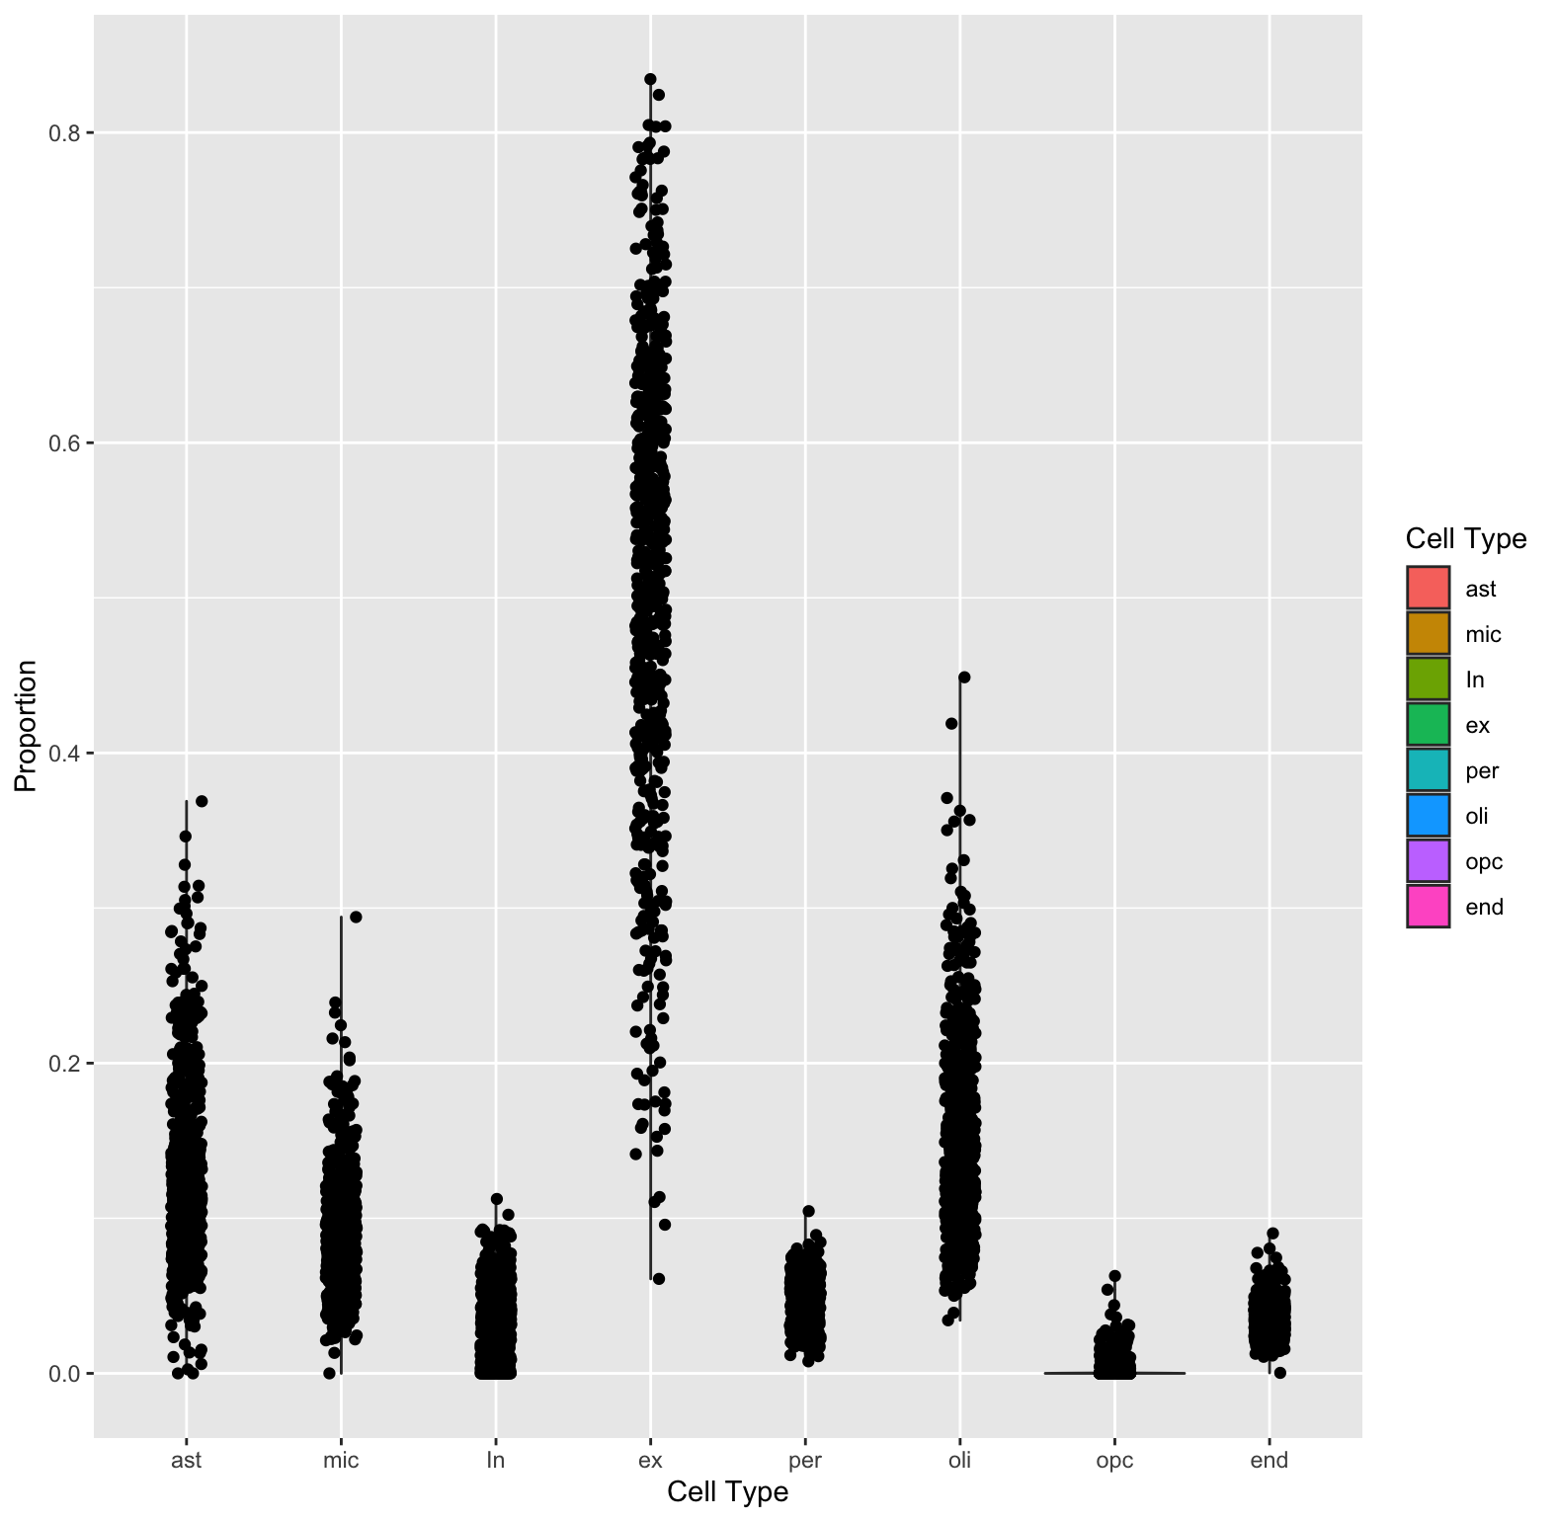
1. Select reference based on proportion
B mode
S mode

Slide 17
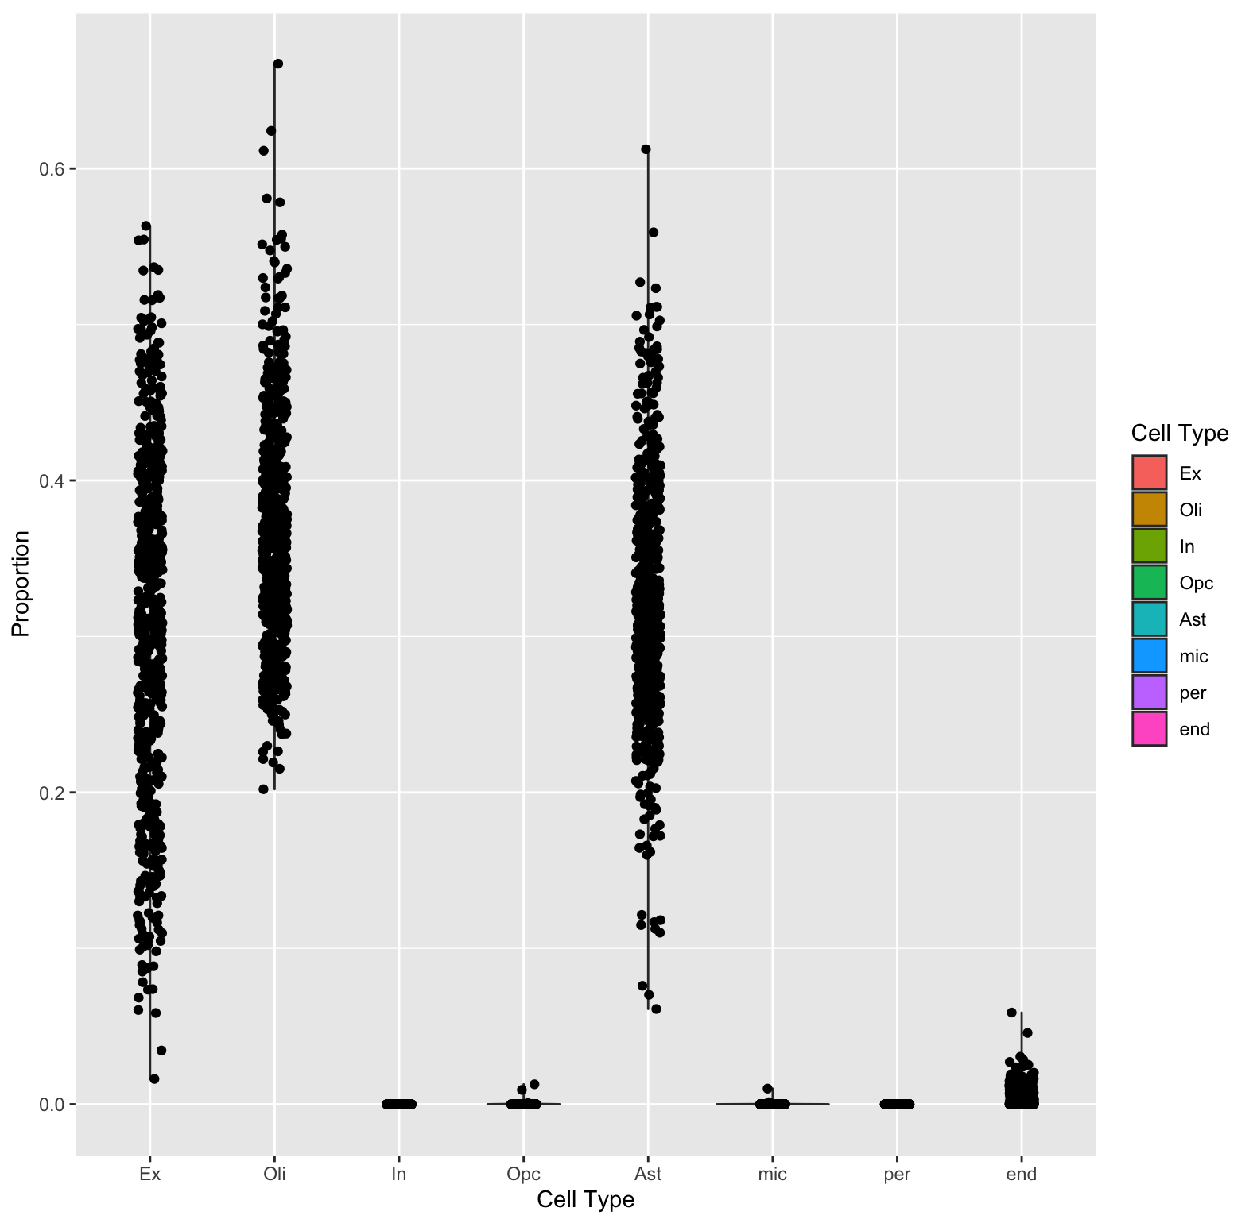
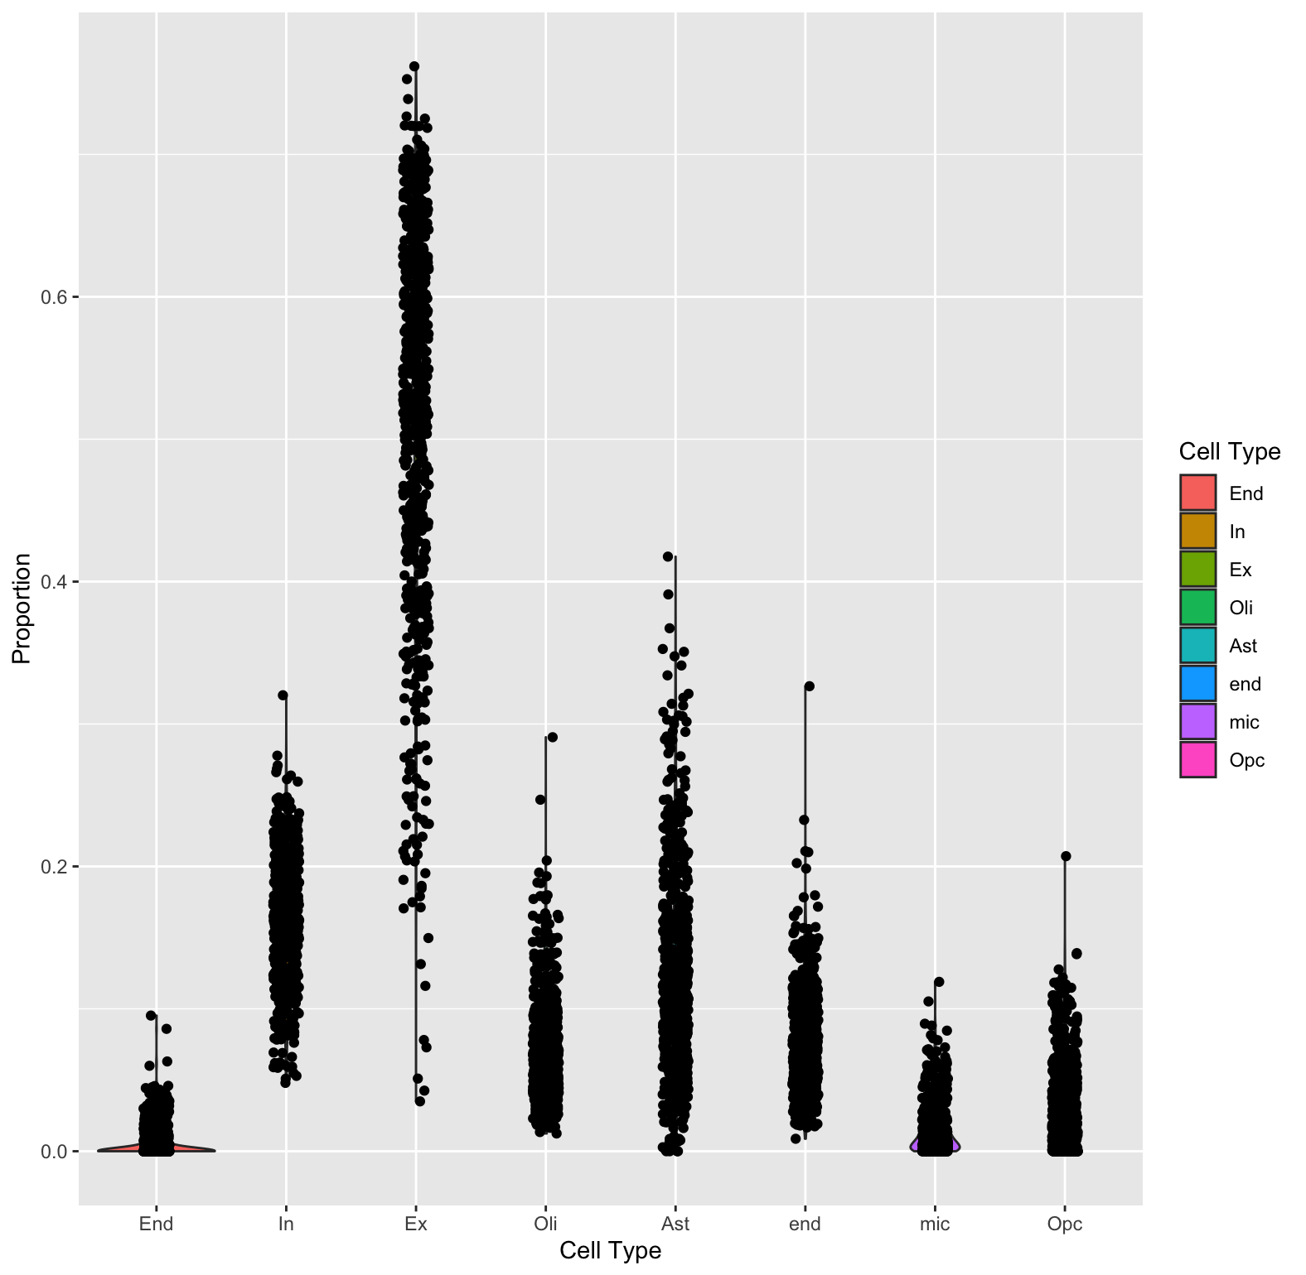
2. Select reference based on gene expression
B mode
S mode

Slide 18
CibersortX update
For each individual, the sum of each gene expression for each cell type was calculated separately.
Get a 17926 x 362 matrix (only 37 individuals have Per and End cell types, all 48 individuals have the other cell types)

Slide 19
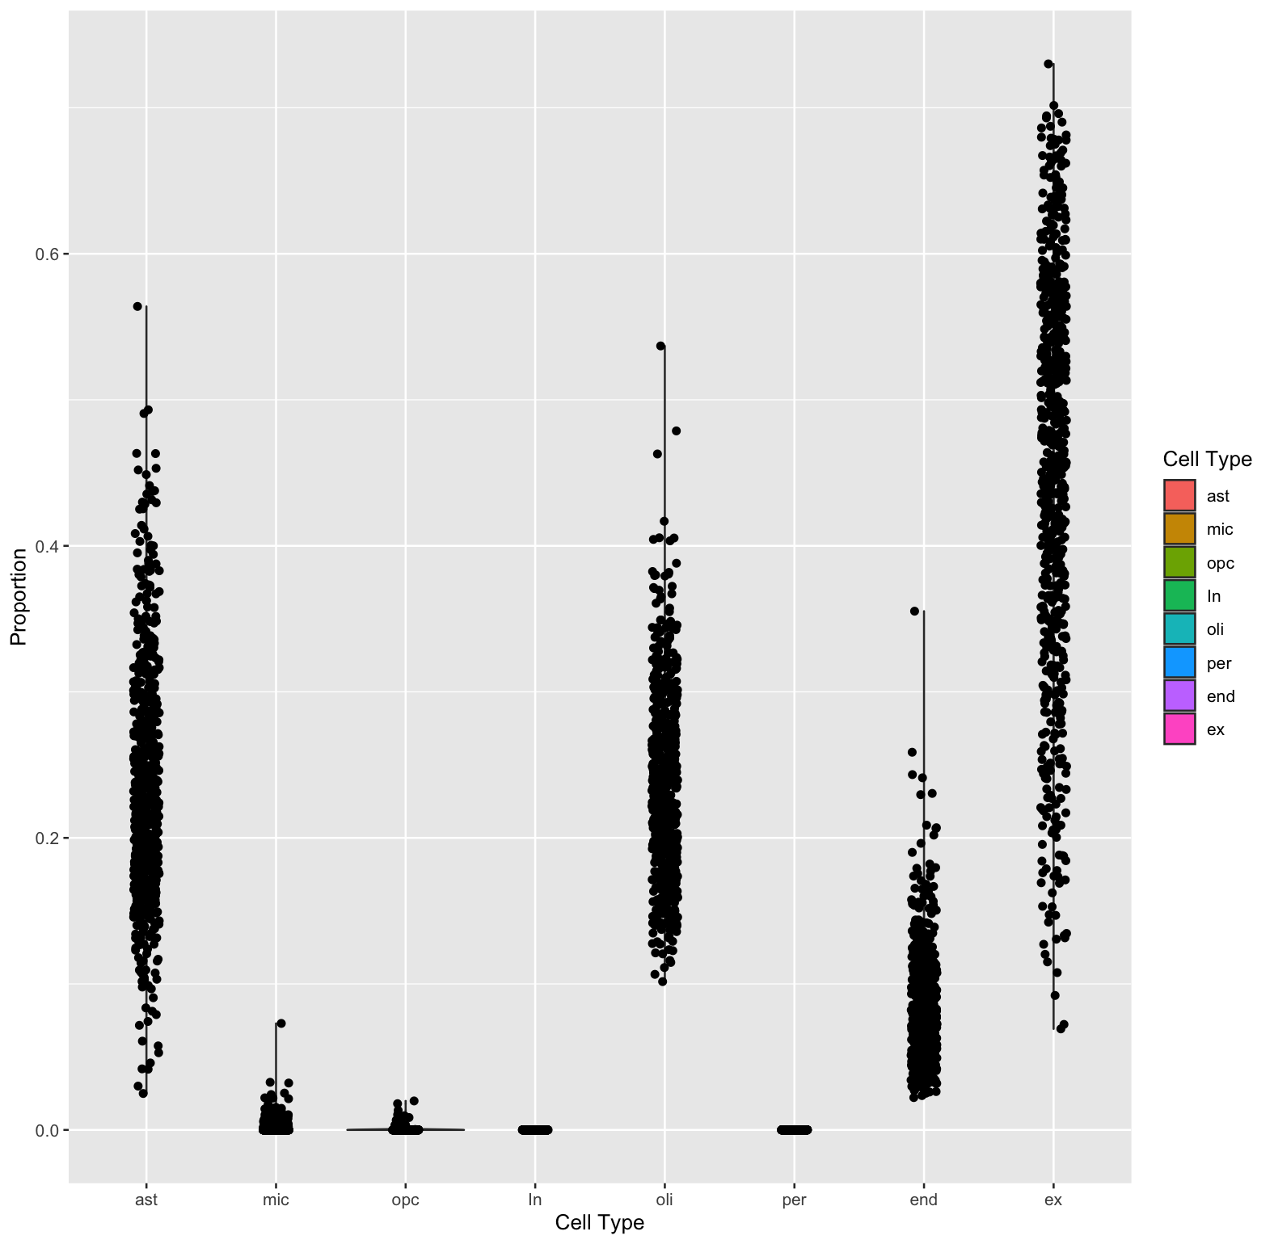
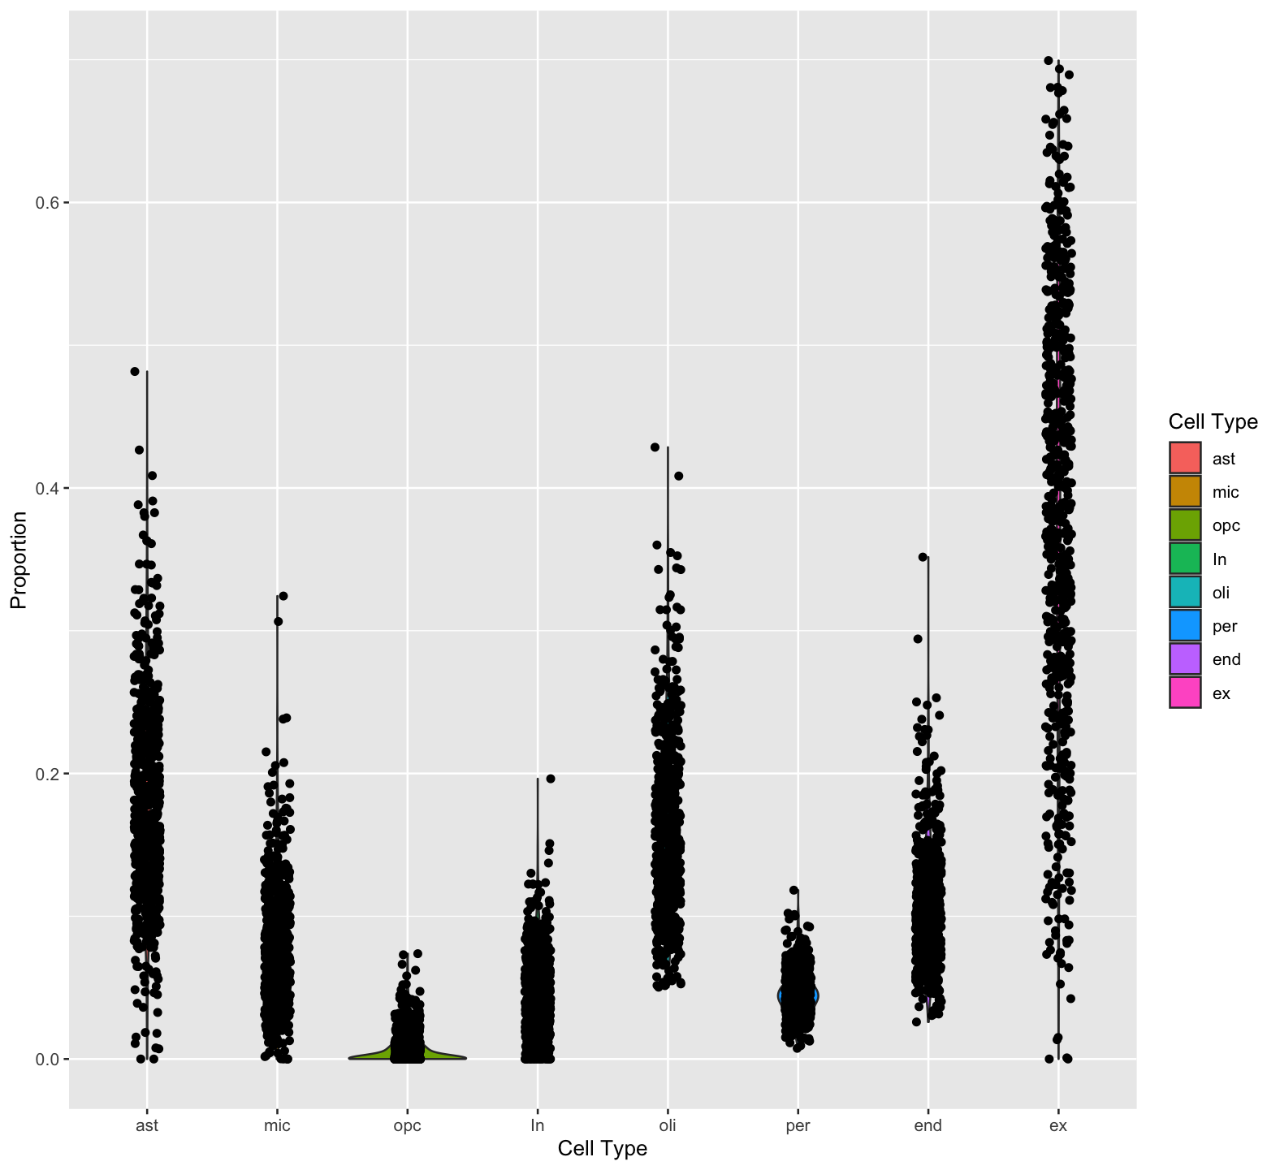
Individuals' gene expression as reference
B mode
S mode

